Slide 1
Contractor Approved Supplier
Who Is That?
Bob Bodemuller
Supplier Quality Principal Engineer

Slide 2


Why A “Contractor-Approved” Supplier?
The term contractor-approved supplier was first used with the release of DFARS 252.246-7008 in 2016.
The purpose of using the term is to recognize that it is the responsibility of the company to have a formal approval process for the use of an independent distributor that includes requirements for counterfeit prevention.

Slide 3
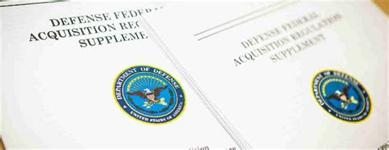
DFARS 252.246-7008 Supplier Categories
Grouped all electronic part procurements into three categories
  Category 1 - Electronic parts that are in production or currently available in stock.
  Category 2 - Electronic parts that are not in production and not currently available in stock from a category 1 supplier.
  Category 3
    Sources other than a category 1 or 2 as defined above
    Electronic parts from a subcontractor (other than the original manufacturer) that refuses to accept flowdown of DFARS 252.246-7008
    Cannot confirm that an electronic part is new or not previously used and that it has not been comingled in supplier new production or stock with used, refurbished, reclaimed, or returned parts.

Slide 4

Who Are These Suppliers?
Category 1: The contractor shall obtain such parts from
  the original manufacturer
  their authorized suppliers
  or from suppliers that obtain such parts exclusively (directly) from the original manufacturers of the parts or their authorized dealers.
Category 2: The contractor shall obtain such parts from suppliers identified by the contractor as contractor-approved suppliers, subject to certain conditions (such as test and inspection).
Category 3: The contractor may buy such electronic parts subject to certain conditions
NOTE: Category 2 and 3 suppliers may require prior approval by MFC

Slide 5


Source Qualification
Category 1: - normal processes
Category 2: - identified by the Contractor as contractor-approved suppliers:
  For identifying and approving such contractor approved suppliers, the contractor uses established counterfeit prevention industry standards and processes (including inspection, testing, and authentication)
  The contractor assumes responsibility for the authenticity of parts
  The selection of such contractor-approved suppliers is subject to review and audit and approval by the contracting officer.

Slide 6
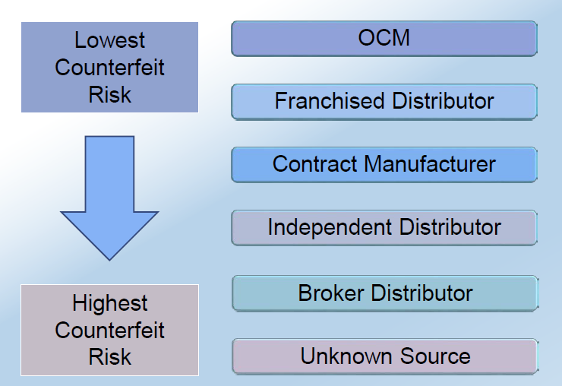
Source Qualification
Category 3: -
  Promptly notify the Contracting Officer in writing.
  Be responsible for inspection, testing, and authentication, in accordance with existing applicable industry standards
  Make documentation of inspection, testing, and authentication of such electronic parts available to the Government upon request
Secondary Sources

Slide 7
Contractor-Approved Supplier Procurements Test/Inspection
For EEE components purchased from a source not authorized by the OCM and/or the OEM MFC requires the use the test and inspection methods defined in the AS6171 Standard (Test Methods Standard; General Requirements, Suspect/Counterfeit, Electrical, Electronic, and Electromechanical Parts), Moderate Risk, Model 2 from Tables 6A, 6B and 7. The AS6171 risk model shall not need to be used.
  The minimum test requirements and sample sizes are summarized in the table on the following page.
  Test and inspections can be added but not deleted.
It is preferred that the test house be certificated to the test methods being performed per ISO 17025.
Testing shall not be performed by the independent distributor where the parts are procured. An independent 3rd party test house shall be used to prevent conflict of interest in test results.

Slide 8
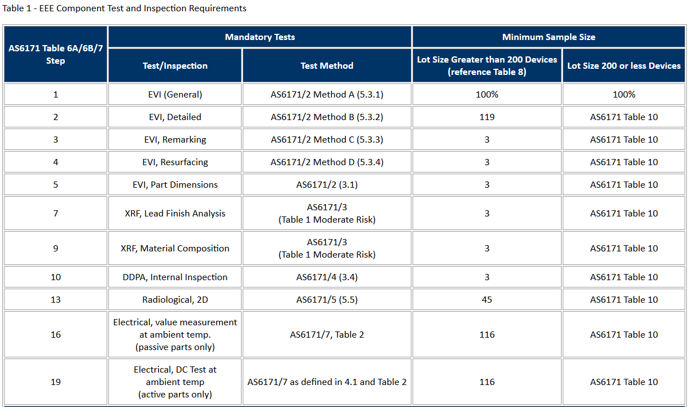

Electronics Minimum Test Requirements
For procurements from Secondary Sources or a supplier who refuses the DFARS252.246-7007/7008 flow down.
From Command Media 4-2-072, COUNTERFEIT AVOIDANCE AND SECONDARY SOURCE PROCUREMENTS

Slide 9
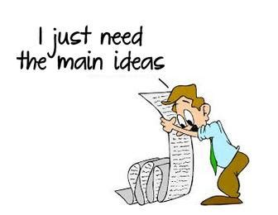
Summary
A contractor-approved supplier can only be used if:
  The part being procured is no longer in production AND is not in stock by the OCM or an authorized distributor
  Prior approval from MFC, i.e. a waiver to the DFARS requirements, has been obtained if the part is still in production but has excessive lead times that do not support schedules (need for convenience) for a specific procurement
A contractor-approved supplier must have a site audit to an industry recognized standard. This can include a 3rd party accreditation from an IAF approved certification body
  AS6081 for electronics
  AS6174 for other materials
MFC defined tests and inspections from an independent third party test facility must be accomplished and approved by MFC.

